Slide 1


The Early Prediction of Diabetes
Phoenix Attackers

Slide 2
SUMMARY/DATA UNDERSTANDING
In this project, the objective is to predict whether the person has Diabetes or not based on various features such as
The data set that has used in this project has taken from the Kaggle . "This dataset is originally from the National Institute of Diabetes and Digestive and Kidney Diseases. The objective of the dataset is to diagnostically predict whether a patient has diabetes or not, based on certain diagnostic measurements included in the dataset. Several constraints were placed on the selection of these instances from a larger database. In particular, all patients here are females at least 21 years old of Pima Indian heritage." and used a simple random forest classifier.
Pregnancies | Age
Insulin Level | BMI

Slide 3
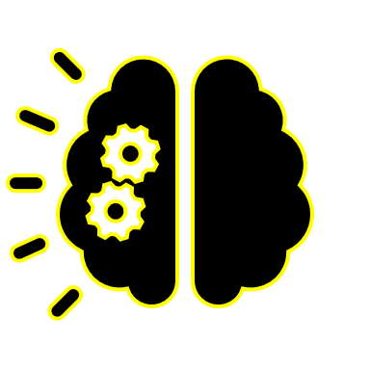
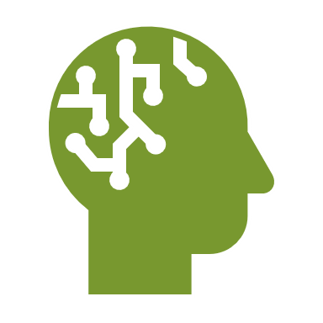

The Problem challenge
Problem Cause of diabetes vary depending on the genetic makeup family, history, ethnicity, health etc.,
Problem Diabetes is one of the deadliest disease in the world which is rapidly increasing.
Problem It is an illness caused because of high glucose ;level in a human body.
01
02
03

Slide 4
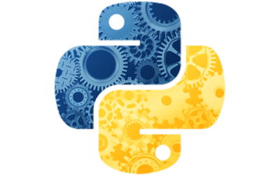





PYTHON
PANDAS
NUMPY
TOOLS
GOGGLE COLLAB
SKLEARN
FLASK

Slide 5

Training a machine learning model using scikit-learn.
Technology
ASPECT
Building a Flask Web App. .
A user must put details like Number of Pregnancies, Insulin Level, Age, BMI etc.
Once it get all the fields information , the prediction is displayed on a new page .

Slide 6
Analysis
Solution Road Map
Business Goal
Data Gathering
Descriptive Analysis
Data
Visualizations
Model Deployment
Model
Evaluation
Data
modeling
Data Preprocessing
Desired Solution

Slide 7
MEET THE TEAM
RAHUL MUVVALA TEAM LEADER,
SKILLS : PYTHON, PRESENTATION
MACHINE LEARNING
KALPANA CHAMALA SKILLS : PYTHON, DOCUMENTATION
HTML, CSS, VISUALIZATION
RISHITHA VENKANNAGARI SKILLS : PYTHON,
MACHINE LEARNING
MASTANVALI SHAIK SKILLS : PYTHON
MACHINE LEARNING
FARHAN SHAIK SKILLS : PYTHON,
FLASK, MACHINE LEARNING

Slide 8

THANK YOU
- Phoenix Attackers

